Slide 1
Recapitulating evolution
of
metabolic networks
Beatrice Bonato
Arián Ferrero
Fukai Chen
Aiganysh Ulanova

Slide 2
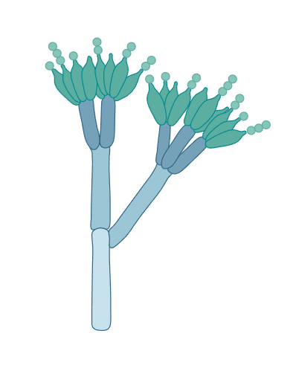

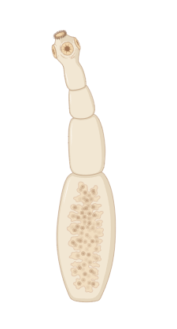


Pathogen definition & types
Pathogen: an organism causing disease to its host
Pathogen
Virus
Bacteria
Fungi
Protozoa
Worms
Notes:
Fukai
So pathogen is defined as an organism that can cause disease to its host, including our human beings. Most of them can be divided into five types.

Slide 3
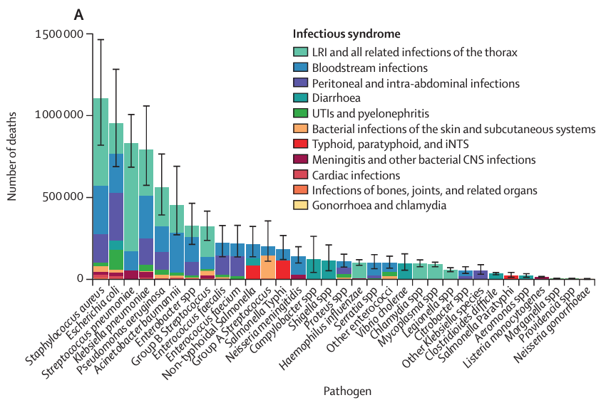
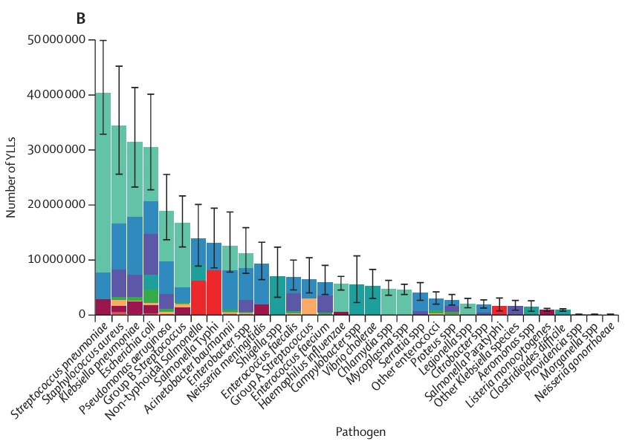
Bacterial infection to human health
YLLs: years of life lost
Pathogen: an organism causing disease to its host
Bacterial pathogen is threatening human’s health
(GBD 2019 Antimicrobial Resistance Collaborators. Lancet 2022)
Notes:
Fukai
Among the pathogens, the bacterial pathogens bring many disease and cost a lot of death, threatening huma’s health
From data in 2019, millions of deaths are caused by pathogen infection. Bacterial pathogen is threatening human’s health

Slide 4
Commensal bacteria vs pathogen
Millions of commensal bacteria inhabit mucosal and epidermal surfaces in humans
Play an important role in defense against pathogens
Can we compare the metabolic differences between commensal bacteria and pathogenic bacteria for therapeutic purposes?
To engineer pathogenic bacteria into commensal bacteria
To inhibit pathogenic bacteria growth
Notes:
Fukai
While, besides the pathogenic bacteria, there are also commensal bacteria, which lives with us. Some studies showed these commensal bacteria can have an important role in defense against pathogens. So can we try to compare the metabolic differences between the commensal bacteria and pathogenic bacteria for therapeutic purposes?

Slide 5
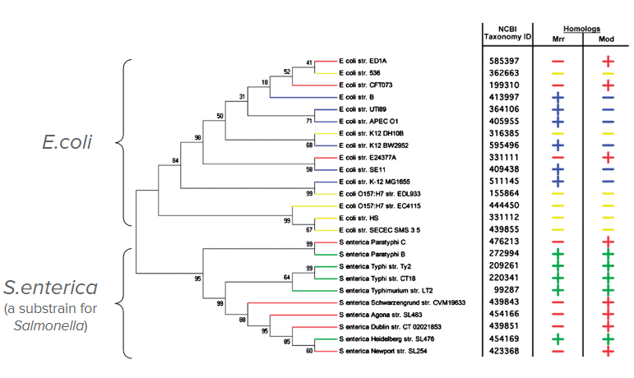
Phylogenetic tree for E.coli and Salmonella
Some studies used gene sequences/expression to classify bacterial strains
But the metabolic properties have not been well studied
(Tesfazgi Mebrhatu M et. al., Nucleic Acids Res 2011)
Notes:
Fukai
In some studies, ppl try to differentiate bacteria strains by gene expression or difference in gene sequence. But in that case, the metabolic properties are not well studied

Slide 6
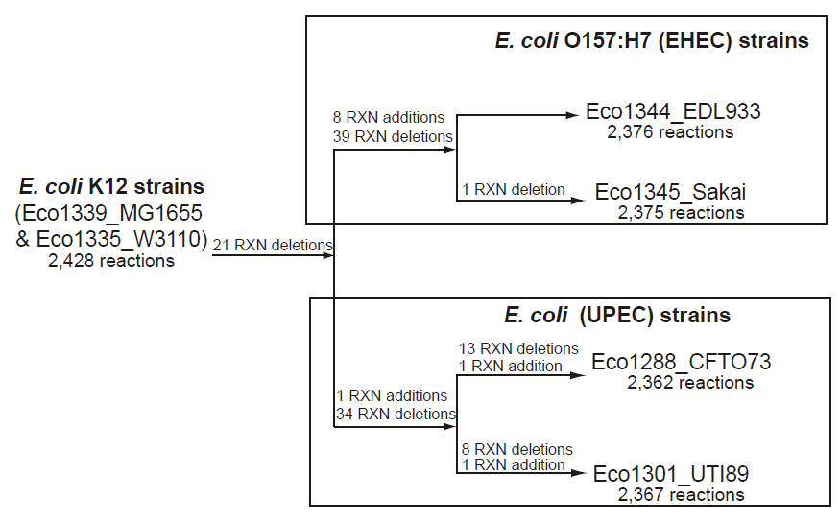
Assay evolution of metabolic networks for E.coli
Use genomic information to construct pangenome for E.coli
Associate genes to protein function and present all metabolic reactions
All genes are classified into orthologous cluster groups (OCGs)
OCGs are analyzed for metabolic roles for adding into the pangenome metabolic network
aim: demonstrate that a pangenome-scale metabolic can be leveraged to construct additional E. coli strain-specific models
(Baumler DJ, et al., BMC Syst Biol 2011)
Notes:
Aiganysh
The GEM for the E. coli ancestral core was made by removing OCGs and their associated reactions if one or more of the sixteen
E. coli genomes did not have a gene assigned to the OCG.
If removing a reaction prevented biomass production for anaerobic growth on glucose
(predicted using FBA) then the reaction was added back to the metabolic reconstruction without a gene associated with it and this occurred 24 times.

Slide 7
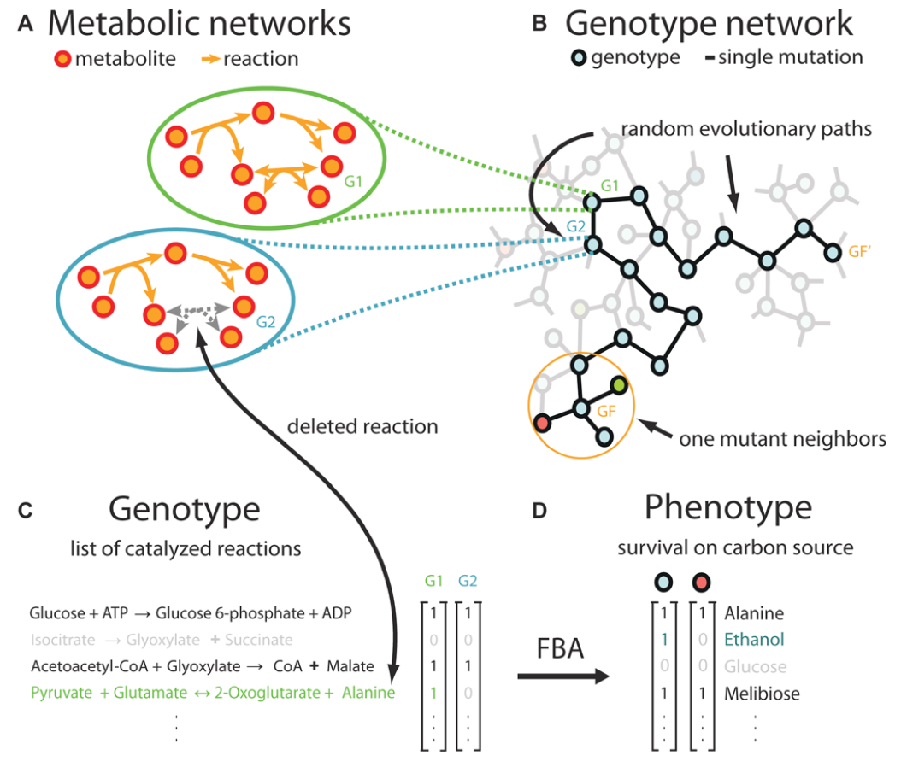
Construct metabolic matrix for comparison
Metabolic genotype can be represented into a binary string
Genotype as for reactions
(1) indicates present of reaction, (0) indicates absence of reaction
Combine genotype and FBA to get metabolic phenotype
Carbon resource for survival
Compare and find evolutionary innovations between strains
(Matias Rodrigues JF & Wagner A, PLos computational biology 2009)
Notes:
Aiganysh

Slide 8
Project Goal
To mimic the metabolic evolutionary path between two bacterial organisms
Identify metabolic network differences between two bacterial organisms using Flux Balance Analysis
Build a model for representing the metabolic phenotypes for comparison
Notes:
Aiganysh

Slide 9
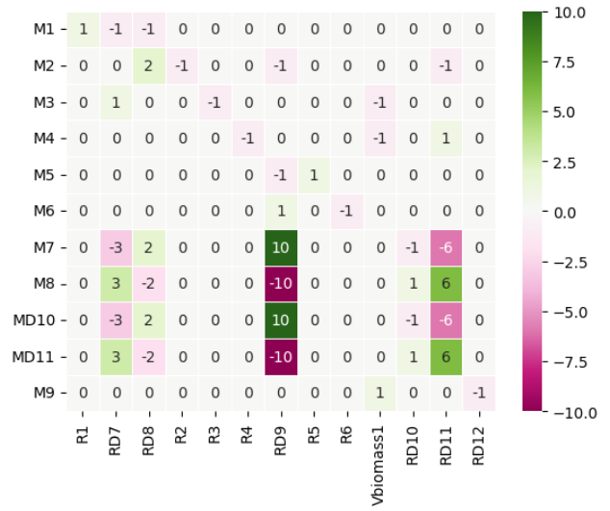
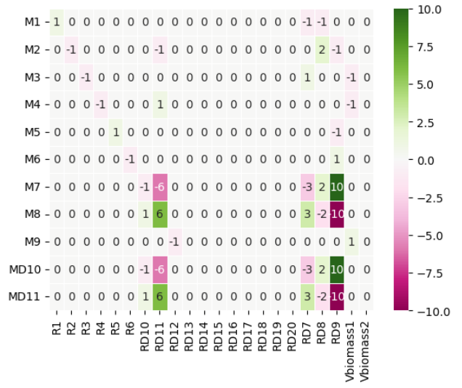
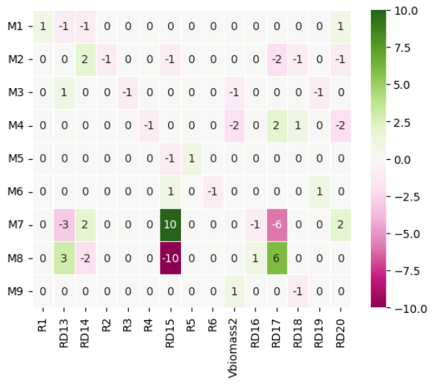
Matrix build and unionization
To present all metabolites and reactions
Stoichiometric Matrix for bacteria 1
Unionization
Unioned Matrix with same size for two bacteria
Stoichiometric Matrix for bacteria 2
Notes:
Fukai
To achieve that, we try to build a toy matrix to represent the metabolic reactions in the bacteria. The code for building the matrix was referred to the code from the class notebook. We modify it and unionized two matrix. So we can have two organism’s metabolic reactions to be shown in the same size matrix for comparison.
Refer to the class notebook and modify it into our own code

Slide 10
Use defined biomass for function optimization
Bacteria 1-specific
Reactions
Consensus Reactions
Bacteria 2-specific
Reactions
Reactions
Biomass
Consensus Biomass
Biomass_1
Biomass_2
Define matrix coefficient for optimized biomass =
Average coefficients of Biomass_1 and Biomass_2
Notes:
Fukai
Then we try to optimize biomass function then compare the metabolic reaction differences between two bacteria. At first, we want to optimize both biomass 1 and 2 in our code, but it turns out that it only optimize one or the other, not both. So we define the a new coefficient for the optimized biomass as the average coefficients from biomass 1 and 2

Slide 11
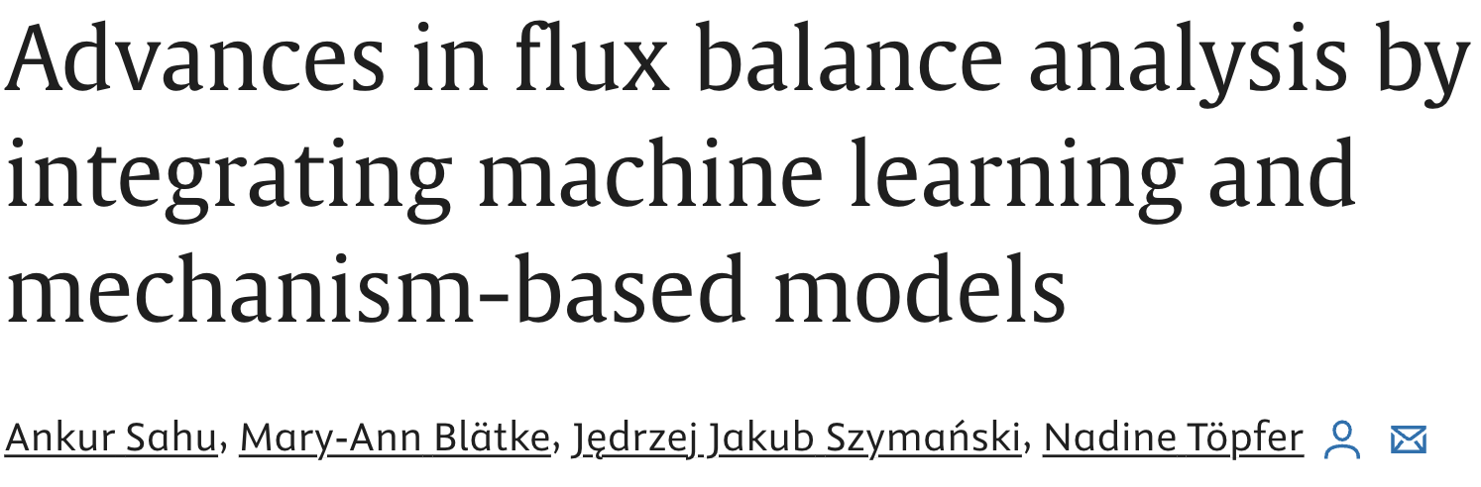
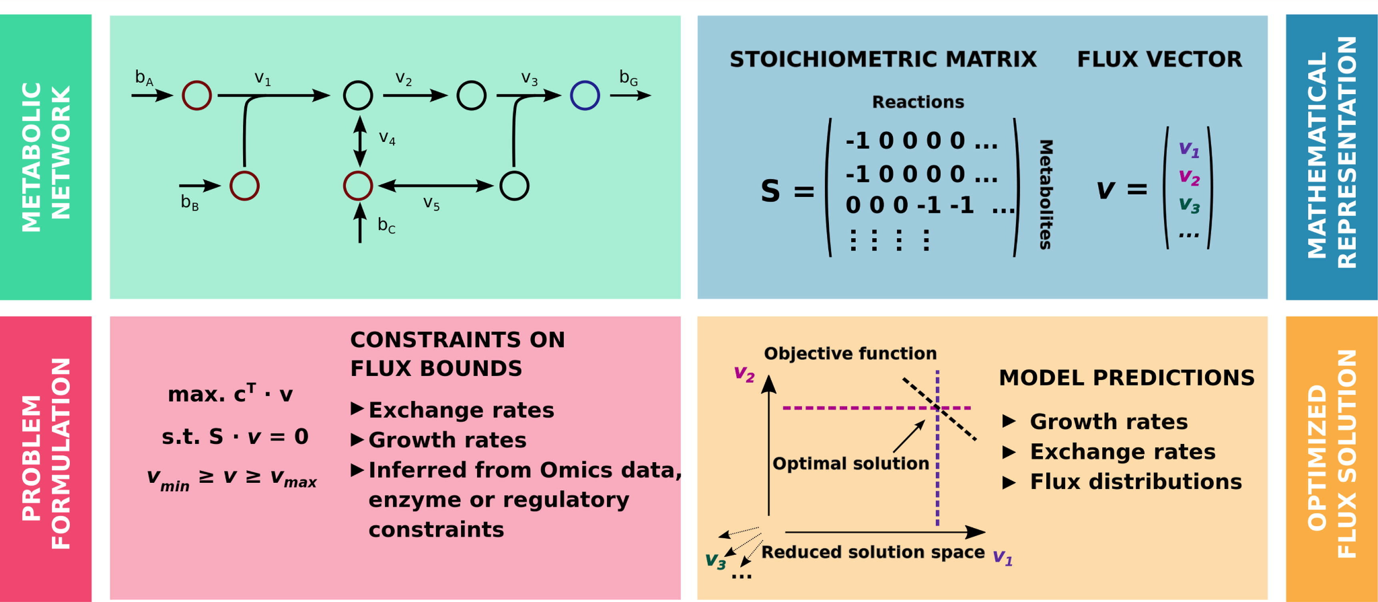
Flux balance analysis as a filter for feasibility
Notes:
Aiganysh
We are using flux balance analysis as a filter for feasibility.
Explain the methodology that we used:
Toy network
Stoichiometric matrix
Problem Formulation
Optimized flux solution

Slide 12
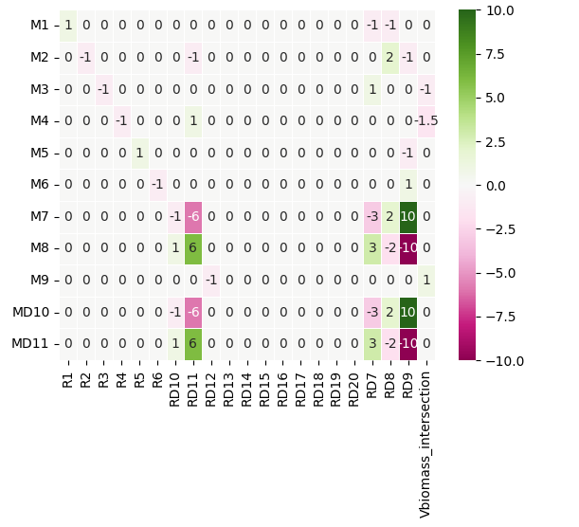
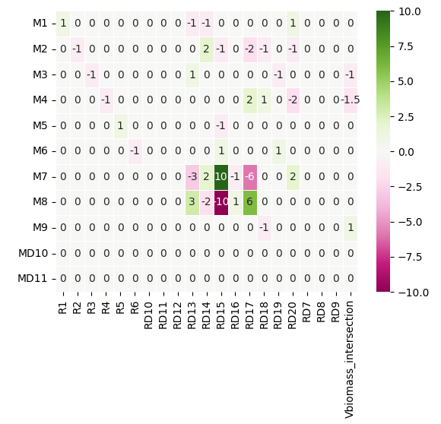
Present reactions in binary string
Bacteria 1
[1,1,1,1,1,0,0,0,1,1,1,0,0,1,1,1,0,0,1,1,0,0]
Bacteria 2
[0,0,0,0,0,1,1,1,1,1,0,1,1,1,0,1,1,1,1,1,1,1]
Metabolites
Reactions
Build Stoichiometric matrix for bacterial organism metabolism profile
Binary string for metabolic reactions to represent each organism
Notes:
Fukai
After that, we use binary string to present the bacteria. 1 means the presence of the metabolic reaction, 0 means absence of the reactions.

Slide 13
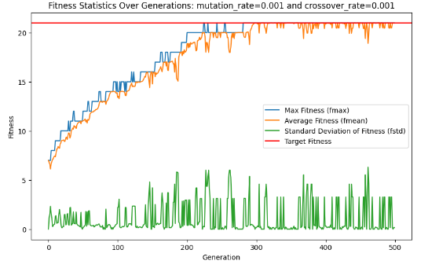
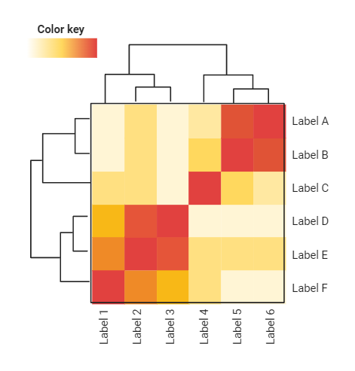
Use genetics algorithms to stimulate mutation
[1,0,0,1,.....1,0] [1,1,0,1,.....1,0] [0,1,0,1,.....1,0] ………. [1,1,1,0,.....0,1] [1,1,1,1,.....0,1]
Generation
Fitness over generations
Reaction changes over generations
(Fitness is defined as similarity between organism and target organism)
Build and compare metabolic evolutionary changes for bacteria
Deletion or addition of metabolic reactions through evolution
Notes:
Aiganysh

Slide 14
Results & key findings
Notes:
Beatirce

Slide 15
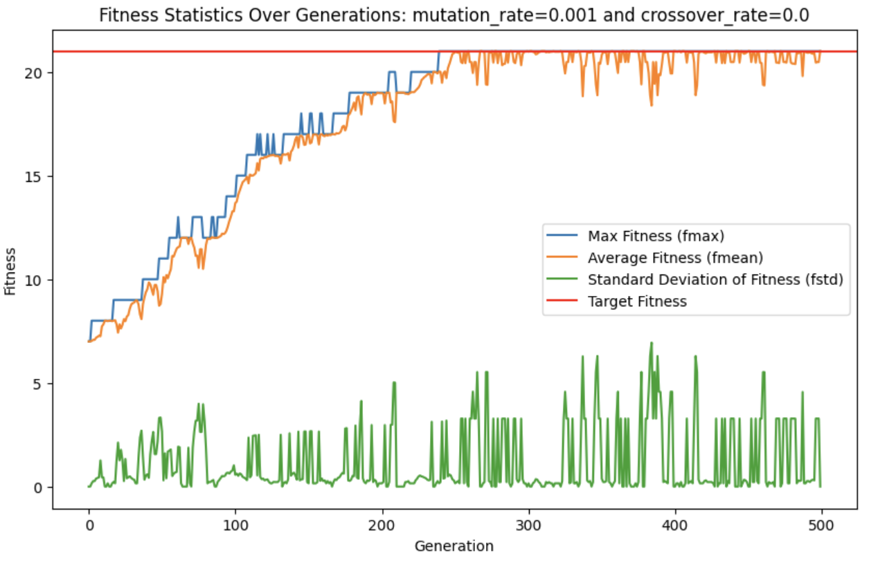
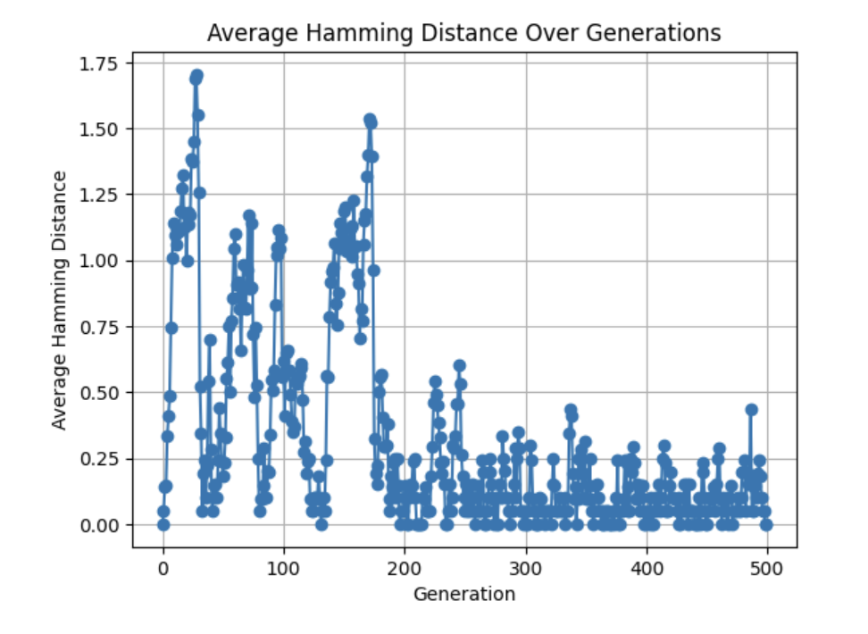
Figure 1: Maximum and average fitness values of the population over 500 generations
Evolution for 500 GENERATIONS
Ideal parameters to reach convergence:
Mutation rate: 0.001
Crossover rate: 0.0
Notes:
Beatrice & Arian

Slide 16
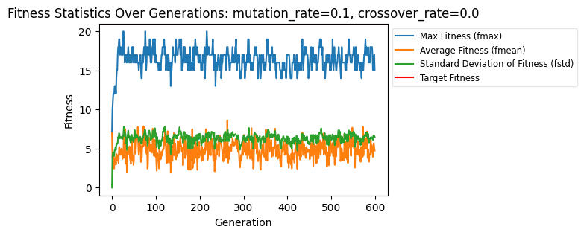
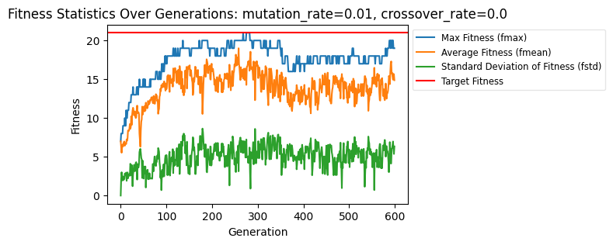
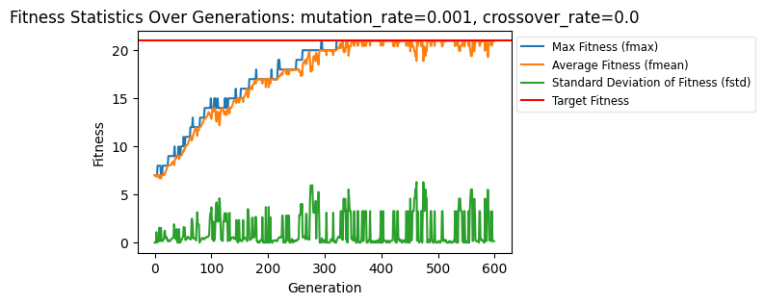
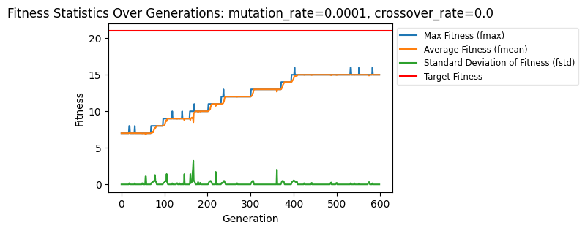
Figure 2: Results for different mutation rates
Notes:
Beatrice & Arian

Slide 17
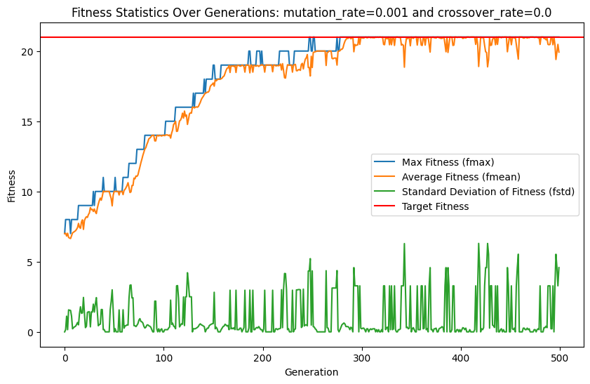
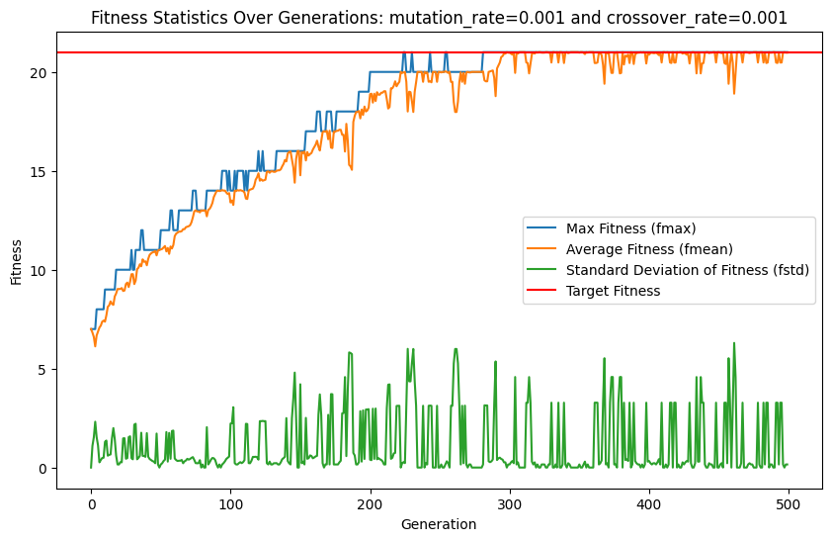
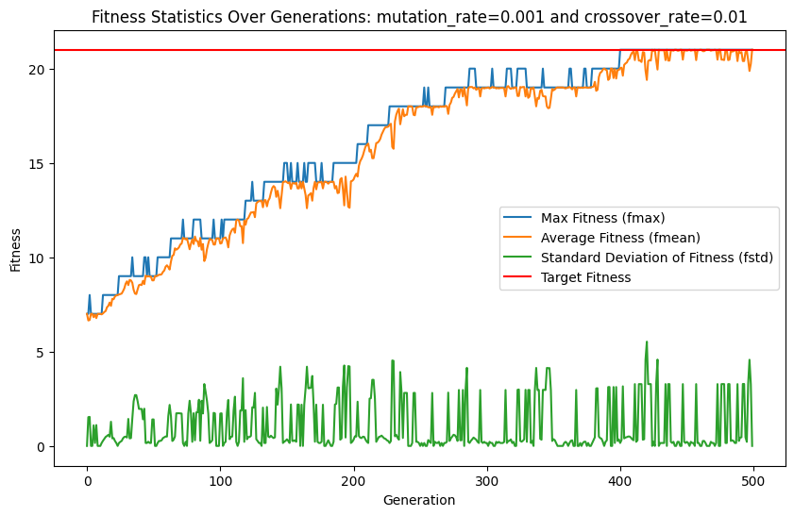
Figure 2: Maximum and average fitness values of the population over 500 generations
With three different set of parameters:
mutation_rate=0.001, crossover_rate=0.0
mutation_rate=0.001, crossover_rate=0.001
mutation_rate=0.001, crossover_rate=0.01
Notes:
Beatrice & Arian

Slide 18
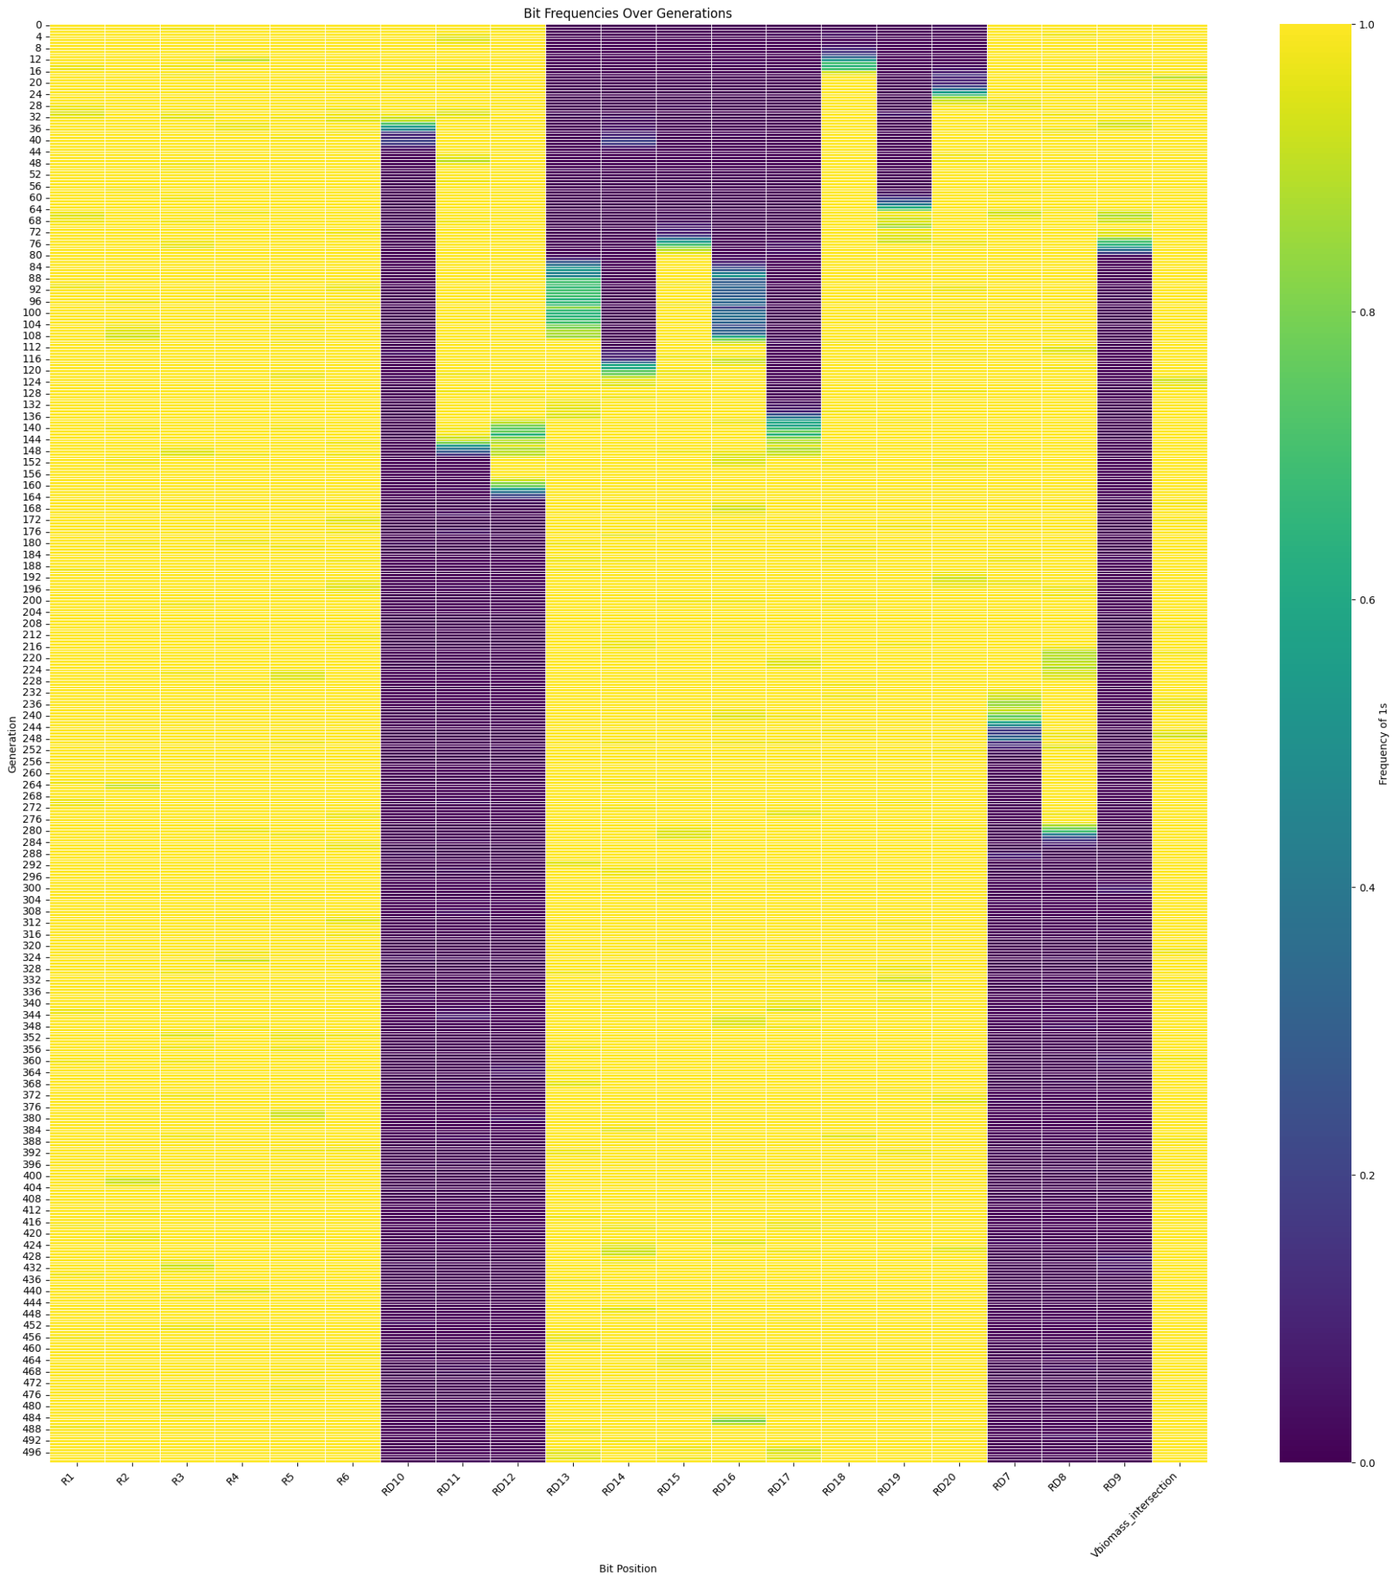
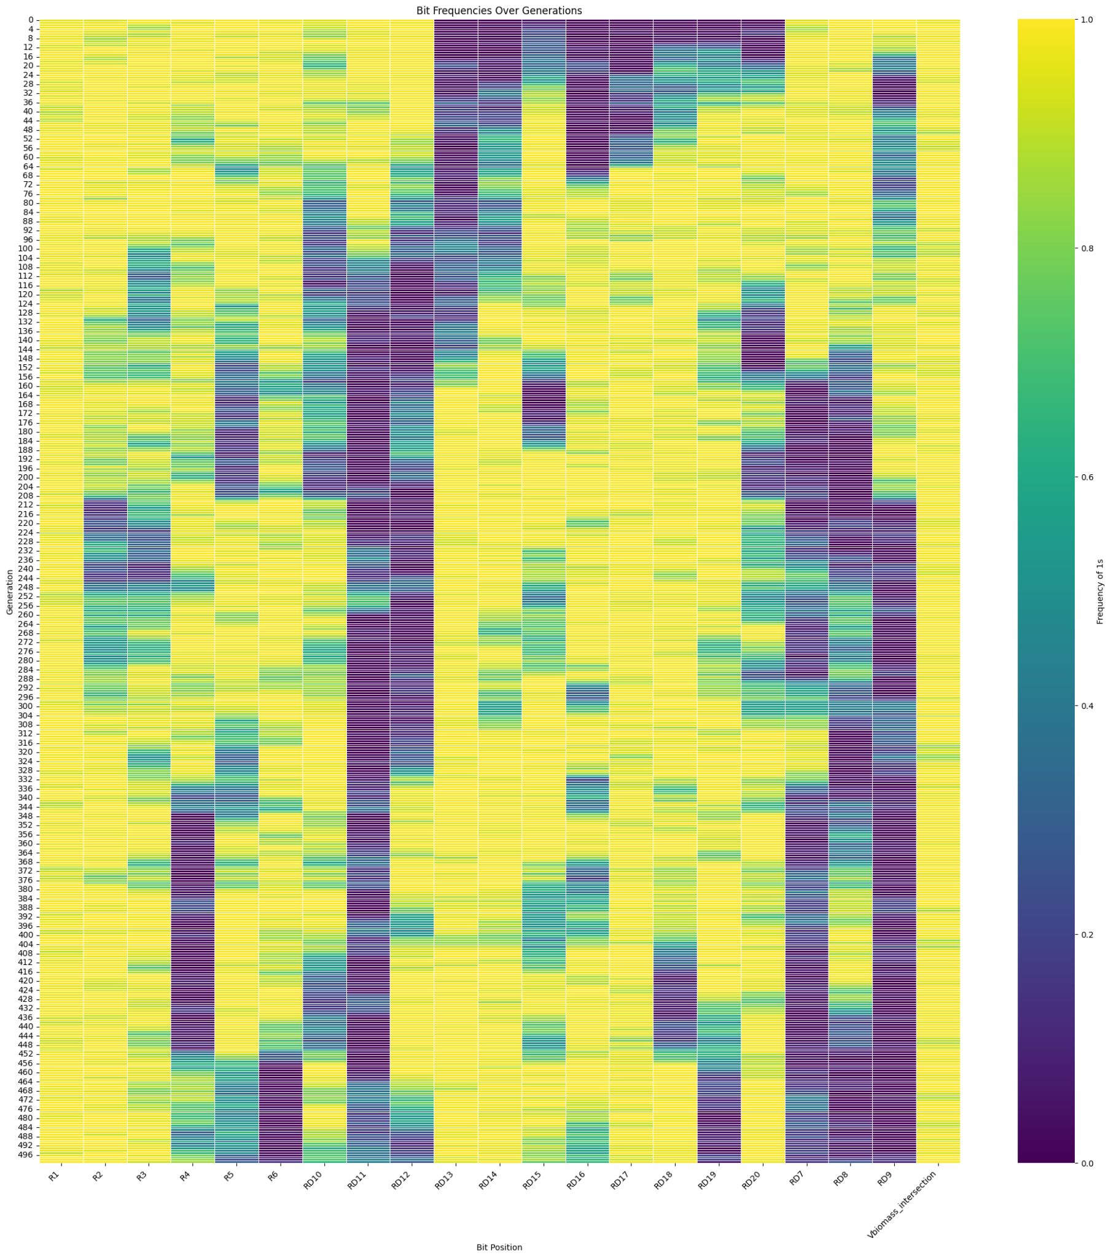
Figure 4: Heatmap for 500 generations
Each row represents a generation and each column represents a bit position in the binary strings. Color coding indicates the frequency of '1's in that position across the population, highlighting how certain bits (reactions) become more or less common over time.
mutation_rate=0.001
crossover_rate=0.0
mutation_rate=0.01
crossover_rate=0.0
Notes:
Beatrice & Arian

Slide 19
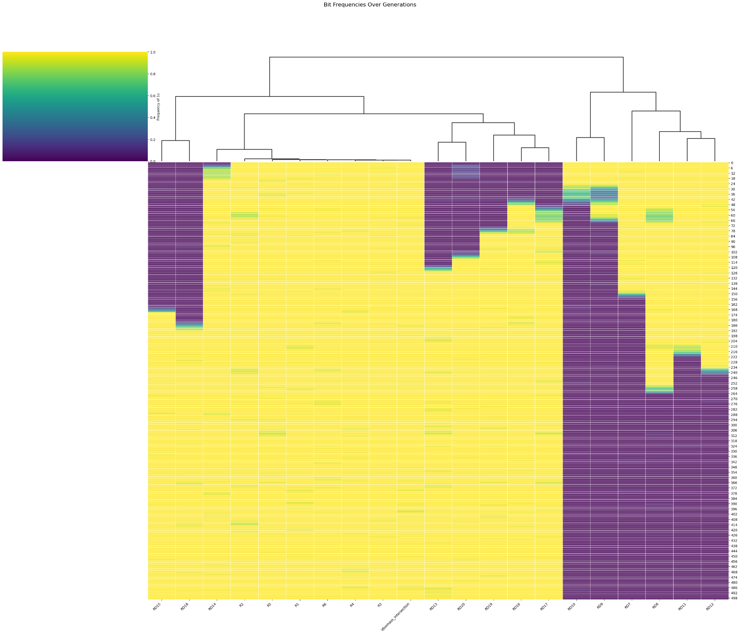
Figure 5: Reactions Clustering
Evolution for 500 generations with parameters:
mutation_rate=0.001
crossover_rate=0.0

Slide 20
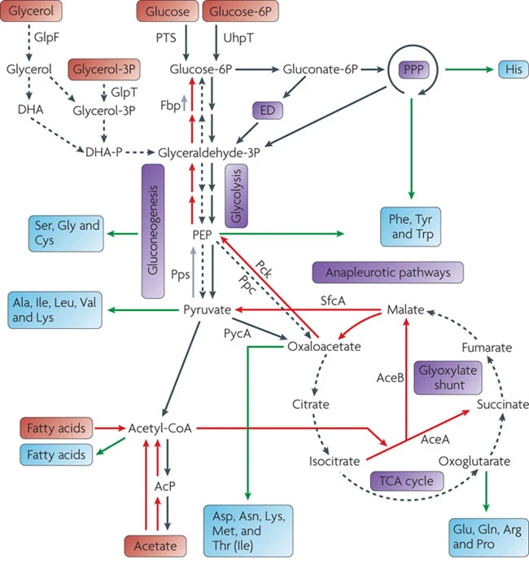
Future directions for study
Perform analysis using real organism
Divergence from pathogenic to non-pathogenic organism
Implement real metabolites and reactions
Different carbon source or nutrient environments
1-carbon source or multiple carbon sources
Nitrogen, Sulfur
Eisenreich, W., Dandekar, T., Heesemann, J. et al. Carbon metabolism of intracellular bacterial pathogens and possible links to virulence. Nat Rev Microbiol 8, 401–412 (2010). https://doi.org/10.1038/nrmicro2351
Notes:
Everybody can contribute to this slide
Environmental conditions
Aerobic vs anaerobic

Slide 21
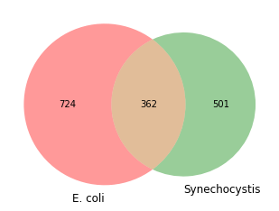
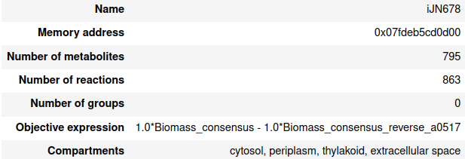

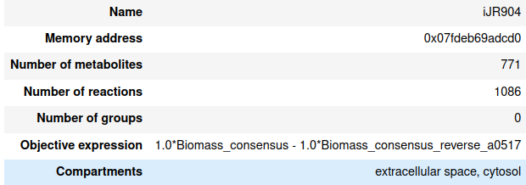
Application to real organisms
Shared reactions
Synechocystis sp. PCC6803
Fitness
Escherichia coli

Slide 22
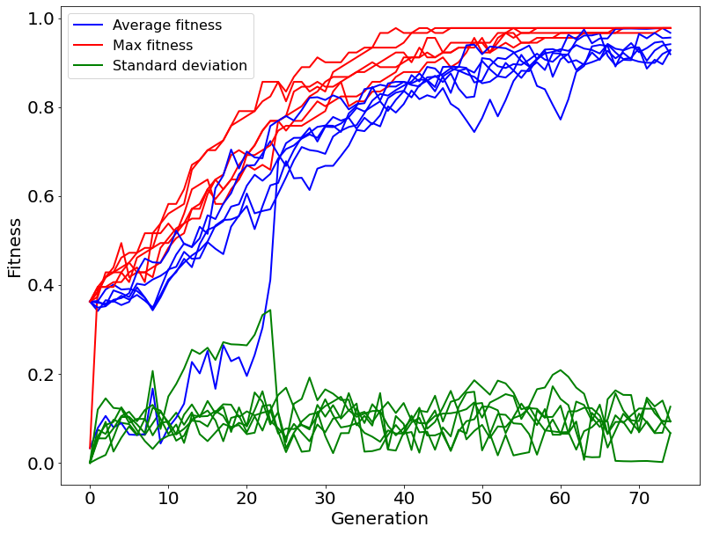
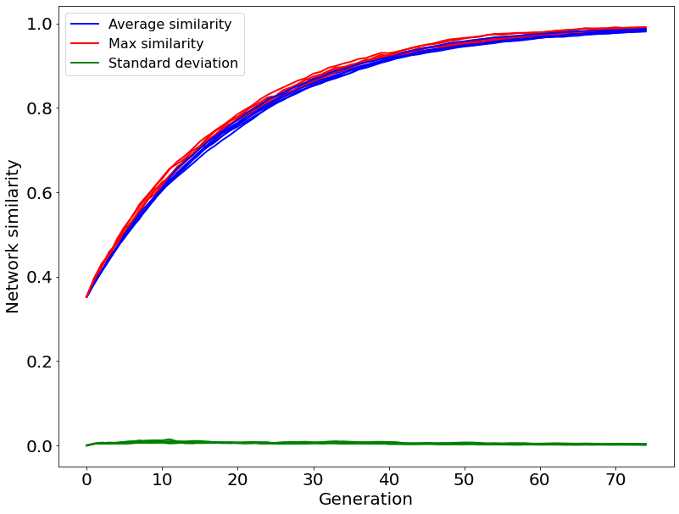
Application to real organisms
Fitness evolution
Network similarity
Results of 6 different replicates

Slide 23
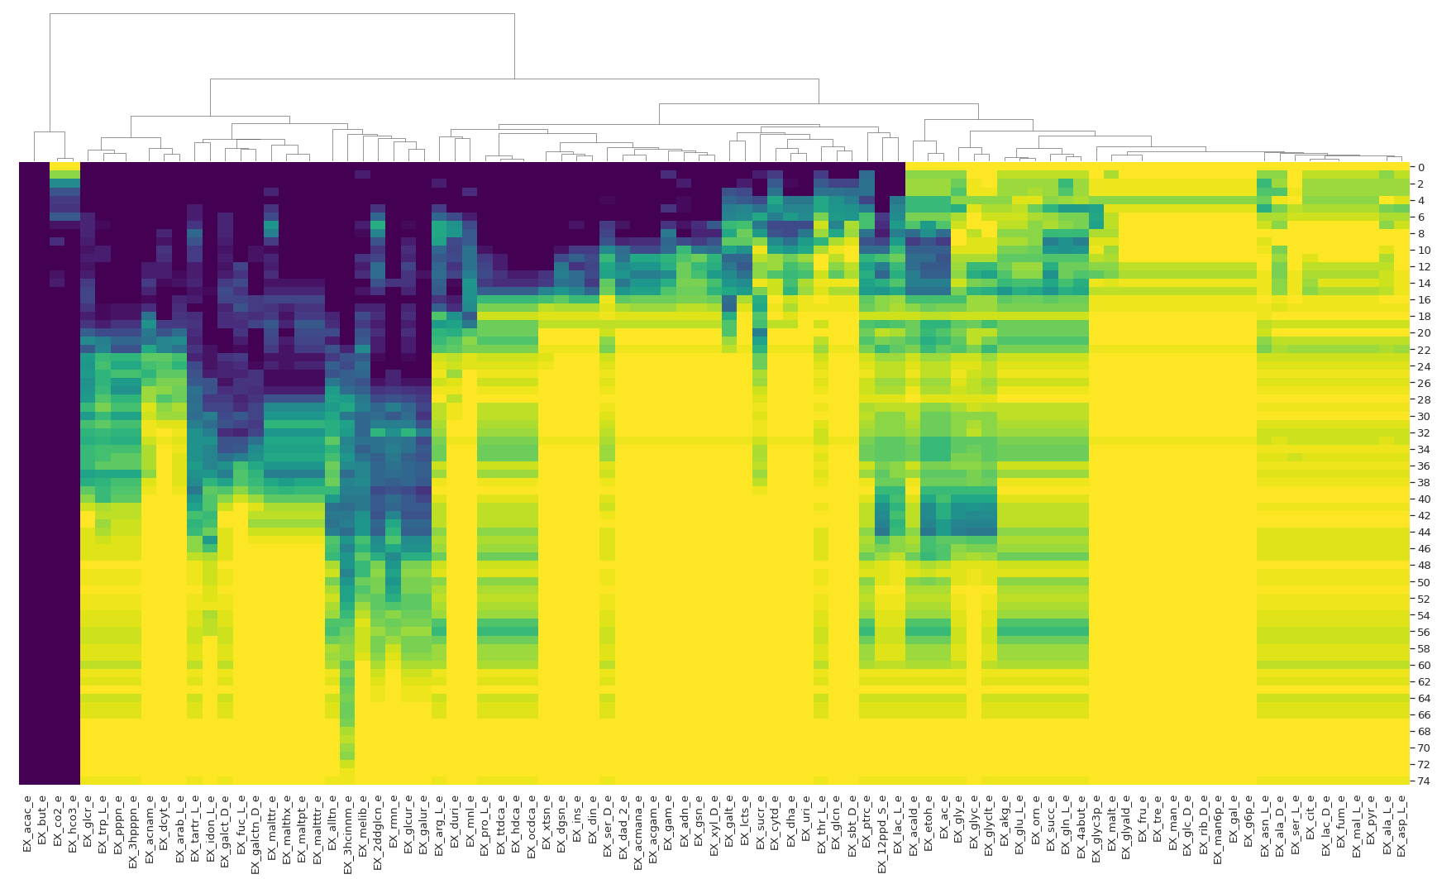
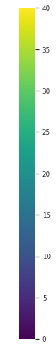
Application to real organisms
The color gradient represents the number of individuals that are able to grow on each carbon source (total population size = 40)
Generation
Carbon sources

Slide 24
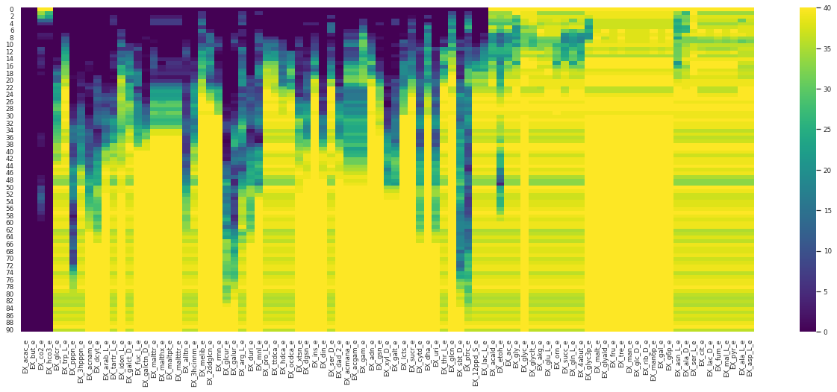
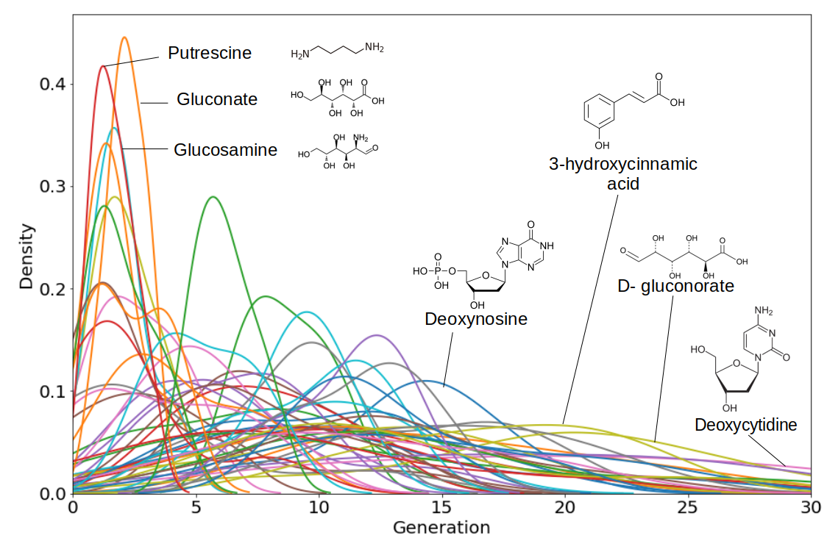
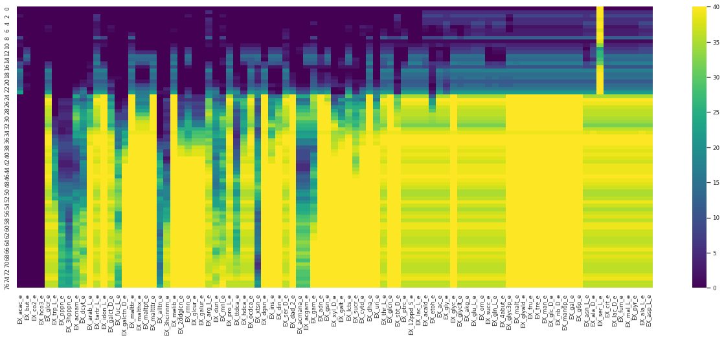
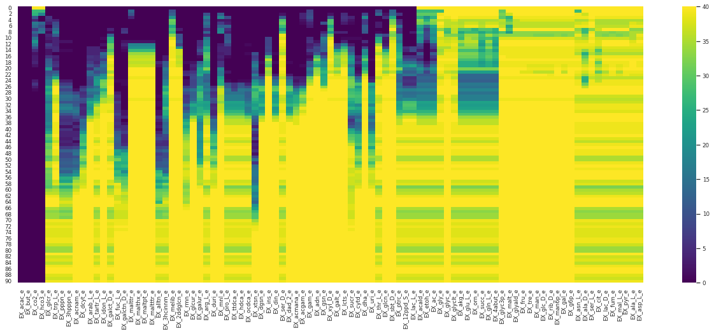
Application to real organisms
There are patterns in the order in which the different carbon sources can be utilized
More complex carbon sources take more time to appear in evolution

Slide 25
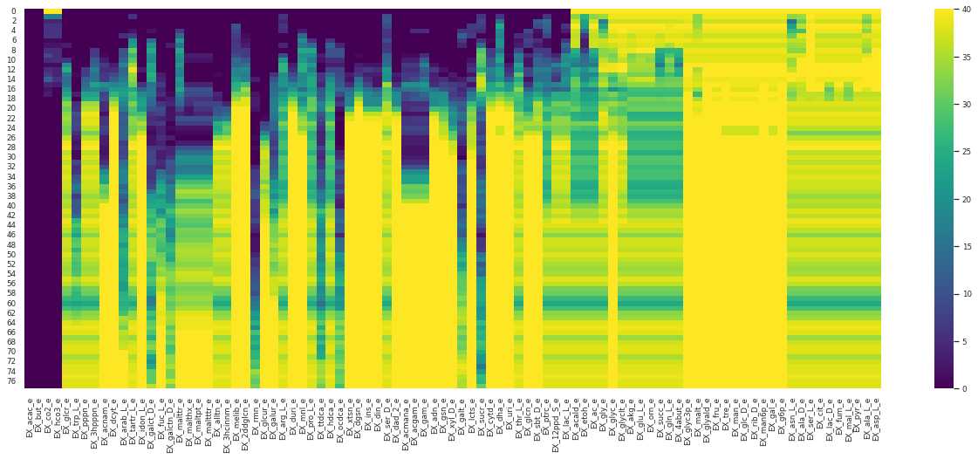
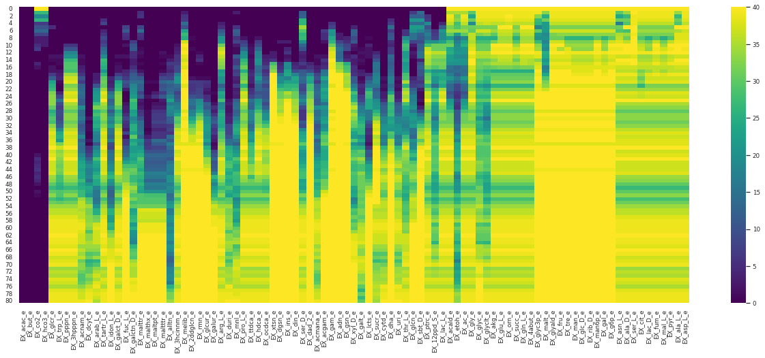
Application to real organisms
There are patterns in the order in which the different carbon sources can be utilized

